Slide 1
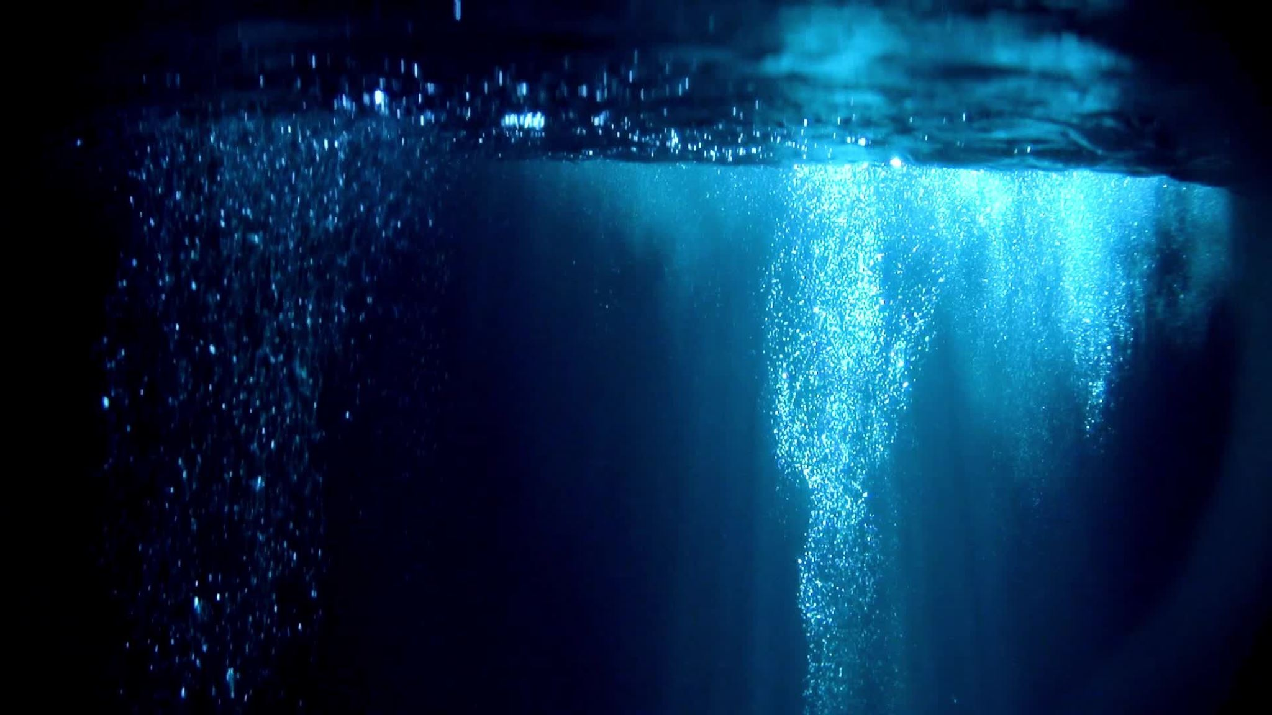
Extreme Sport and Information: Initial Findings of Technical Cave Diver’s Information-Seeking Behaviours
CAIS: May 28, 2025
Dalhousie University, Halifax, NS
Toni Beaton & Dr. Stacy Allison-Cassin
Notes:
Good morning, everyone! My name is Toni Beaton, and I'm here with my research partner Dr. Stacy Allison-Cassin. This morning we’ll be discussing our research, “Extreme Sport and Information: Initial Findings of Technical Cave Diver’s Information-Seeking Behaviours.”
Stacy on original background to the research project.
Let's dive right in!

Slide 2
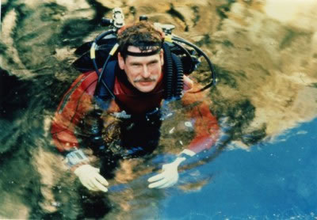
Introduction
Stebbins (2009) defines serious leisure as the term given to niche activities, “which involve significant personal effort based on specially acquired knowledge, training, experience or skill” (p. 625).
Sheck Exley, pioneer of safe cave diving practices.
Image source.
Notes:
Toni: Within research on information behavior, sports are typically lumped in with leisure pursuits, including those categorized as “serious leisure,” sport aligned with lifestyle, or adventure. There has been little research on information-focused activities of extreme sport enthusiasts, especially those involving high-risk behaviors where accurate information can mean the difference between life and death.
Stacy: The intersections of leisure and high-risk and information rich activities lend themselves to a fascinating area for exploring human information interaction, we hope you will enjoy this discussion today and these preliminary results.

Slide 3
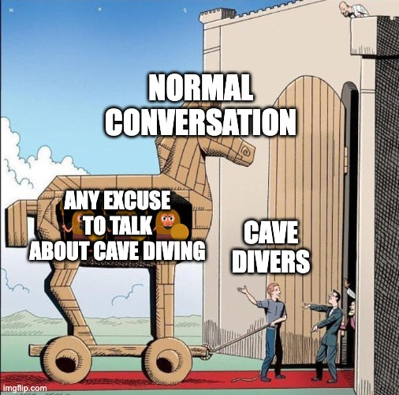
Why Cave Diving?
Notes:
So, why cave diving? If you've ever met a cave diver before, chances are, you've fallen victim to the trap seen on this slide. Cave divers are notoriously obsessed with all things cave diving. But how would I happen to know this?

Slide 4
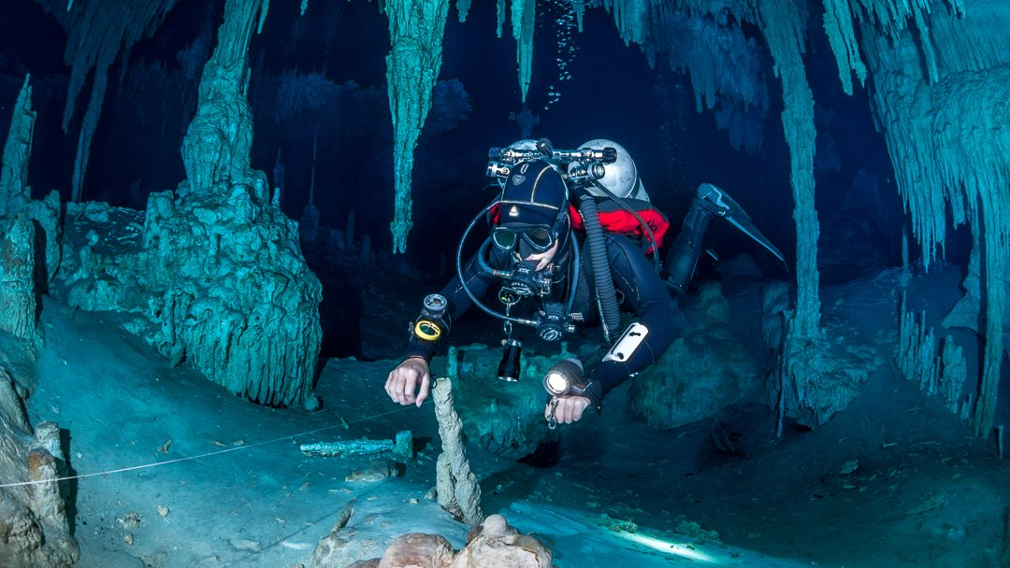
Why Cave Diving? (Really)
Laviolette (2007) explains an appeal of high-risk sports derives from “individually confronting risk” (p. 2) by pitting an individual against a risky environment and overcoming fear.
Extreme or high-risk sports are defined by Breivik (1999) as, “all sports where you have to reckon with the possibility of serious injury or death as an inherent part of the activity.”
Notes:
Because I am a cave diver! But more on that in a moment...
So, why cave diving (really)? [CLICK TO ADVANCE]
Cave diving is a type of technical diving, in which trained divers use specialized equipment to penetrate and explore overhead environments (flooded caves). Because divers cannot directly reach the surface during a dive if an emergency were to arise, the activity is typically characterized as an extreme sport and highly dangerous.
Cave diving is an information-intensive activity. As there is a prominent gap in the Human Information Interaction literature surrounding extreme sport, studying cave diving and information-seeking provides recognition of the critical role information plays.

Slide 5
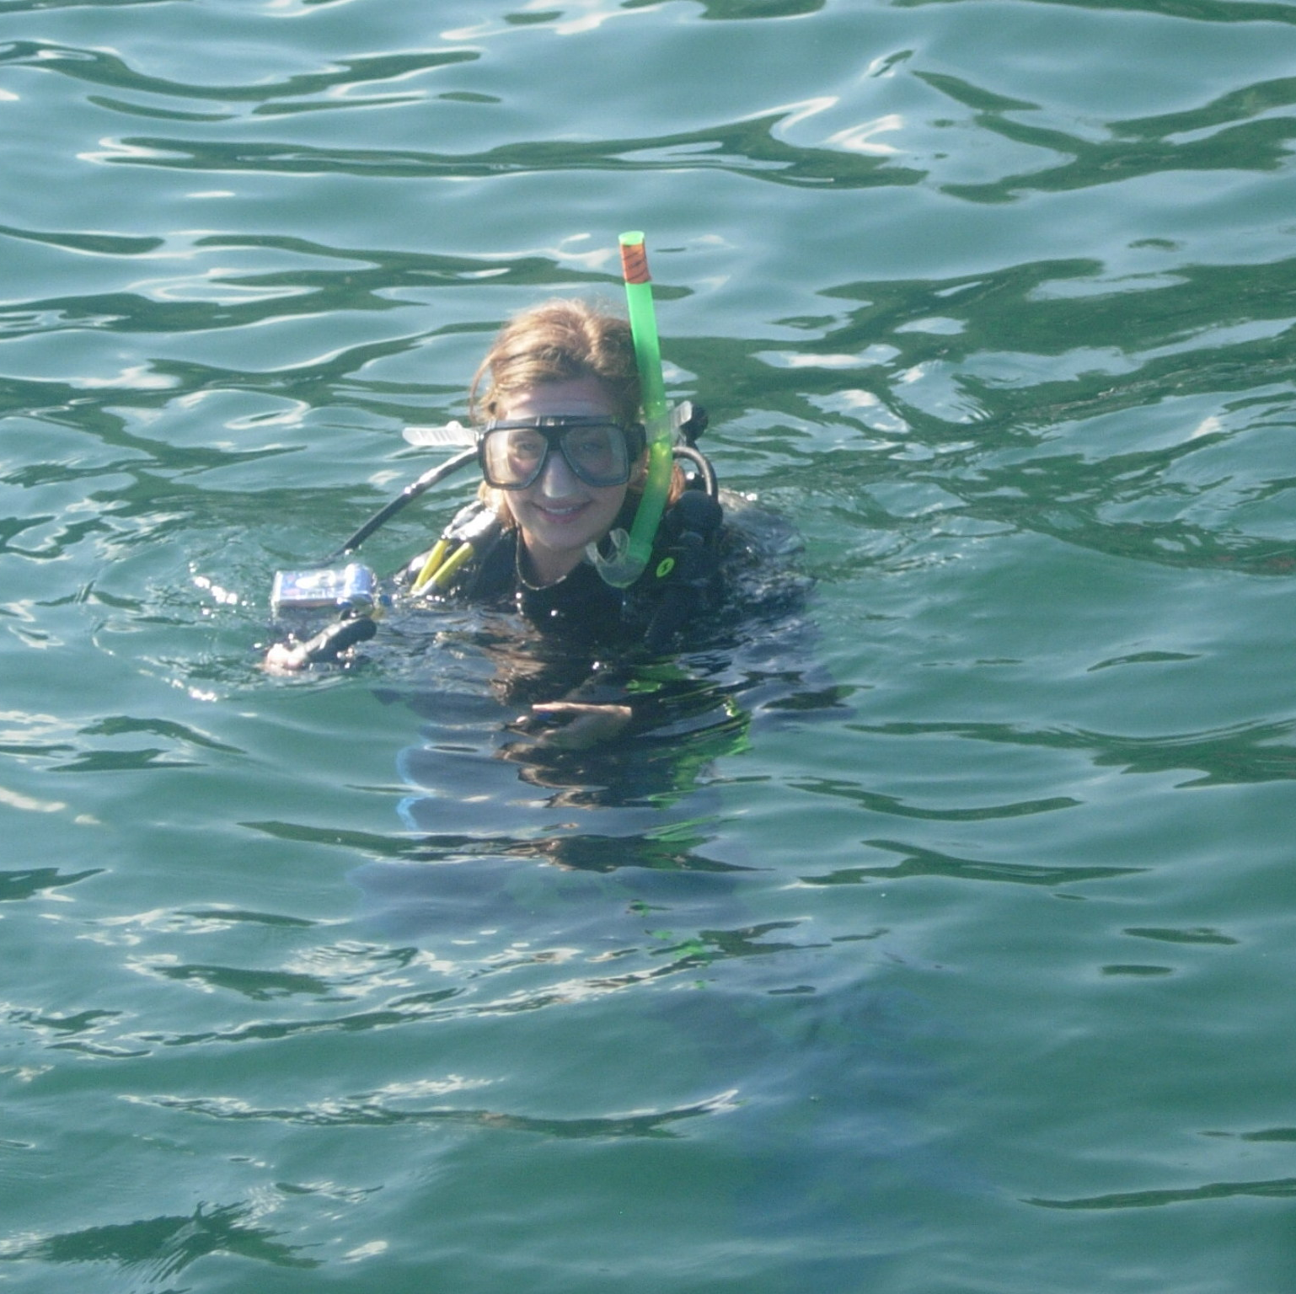

My Diving Background
PADI "Scuba Diver" – 2007
PADI Open Water Diver – 2011
PADI Advanced Open Water Diver – 2013
PADI Enriched Air Diver – 2014
PADI Rescue Diver – 2014
Notes:
To provide you with a bit of context into my background as a cave diver, we need to (briefly) return to 2007. I was 15 years old and completed my first certification under PADI – the Professional Association of Diving Instructors. My "Scuba Diver" cert card allowed me to dive to about 8m or 26 feet with the accompaniment of a certified Divemaster. I gradually completed more courses through PADI, allowing me to dive deeper and longer.

Slide 6
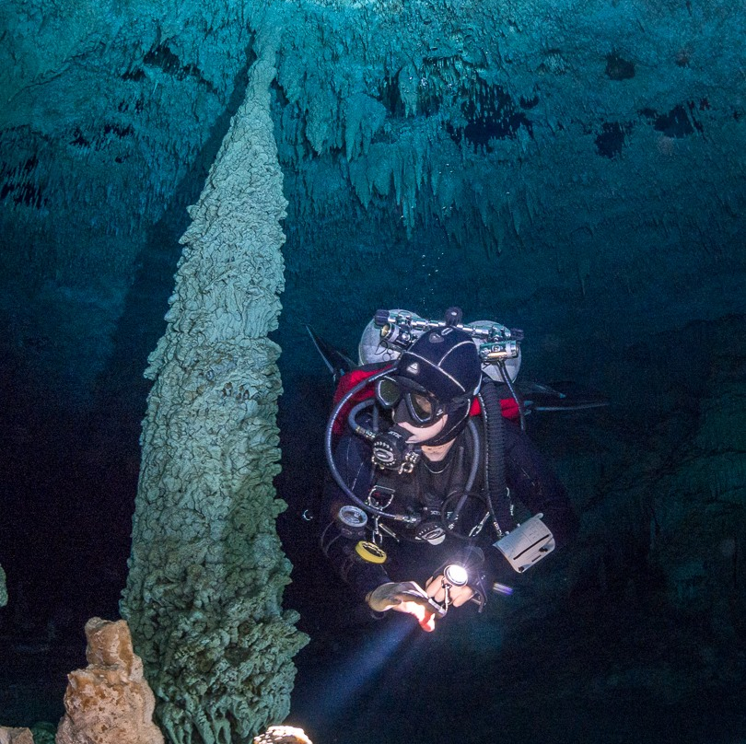

Welcome to the Dark Side...
TDI Cavern Diver – 2017
TDI Tech Diver – 2017
TDI Intro to Cave – 2018
TDI Full Cave – 2018
Notes:
Fast forward to 2017, when my husband and I took a trip to Tulum, Mexico – considered the "Mount Everest" for cave divers due to the overwhelming number of cenotes – or sinkholes – leading to intricate, underground cave systems. I signed up for the TDI Cavern Diver course alongside Paul, as this could be completed recreationally on a single tank (which aligned with my current level of experience at the time). I remember after the 3-day course was finished, I vowed to never go back into a cavern again, I was completely shell-shocked and terrified.
Two days later, I was itching to get back into the caverns.
A year and a half later, I was certified as a technical Full Cave Diver, and well on my way to becoming obsessed with caves.

Slide 7
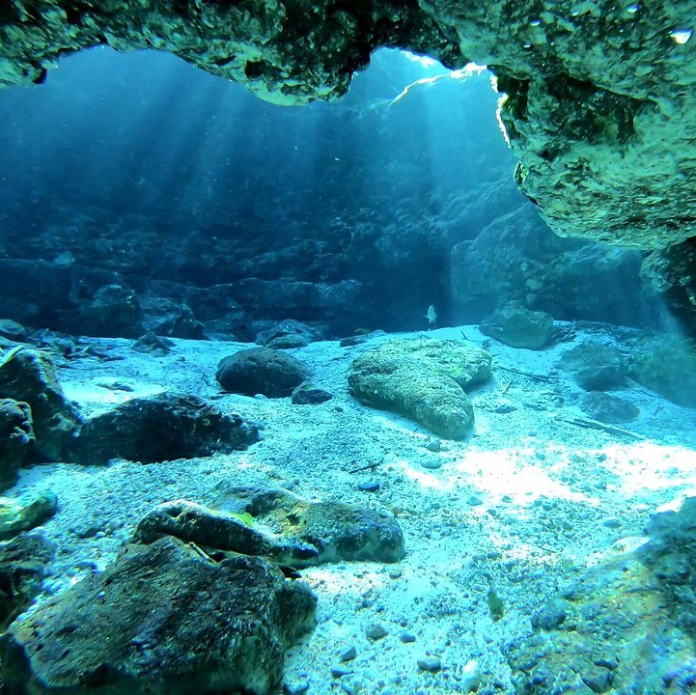
Human Information Interaction
Contemporary HII scholars, including Kari and Hartel, have advocated for research in serious leisure to increase, “…because of the importance of these pleasurable activities to everyday life experience” (as cited in Robinson & Yerbury, 2015, p. 591).
Notes:
Human Information Interaction is the study of how people individually and collectively seek and use information to make sense of their world. HII focuses on how researchers can provide mechanisms for solving information problems, either by creating models or expanding on pre-existing theories.
Information-seeking behavior is concerned with human engagement and challenges faced in interacting with information. Understanding the information-seeking behaviour of those involved in extreme sports, such as cave diving, can provide an additional dimension to understanding the sport itself and extend research on HII and sport.
Stacy: As you will hear, it also provides insights into the ways people treat information sharing when there is risk involved. With thanks to one of the reviewers, applications can also extend to non-leisure situations such as healthcare or high-risk professions.
Toni: This research outlines preliminary findings on the information-seeking behaviors of hobbyist and exploration technical cave divers through an investigation into their “information grounds”: where they go to seek or exchange information about cave diving outside of designated training.

Slide 8
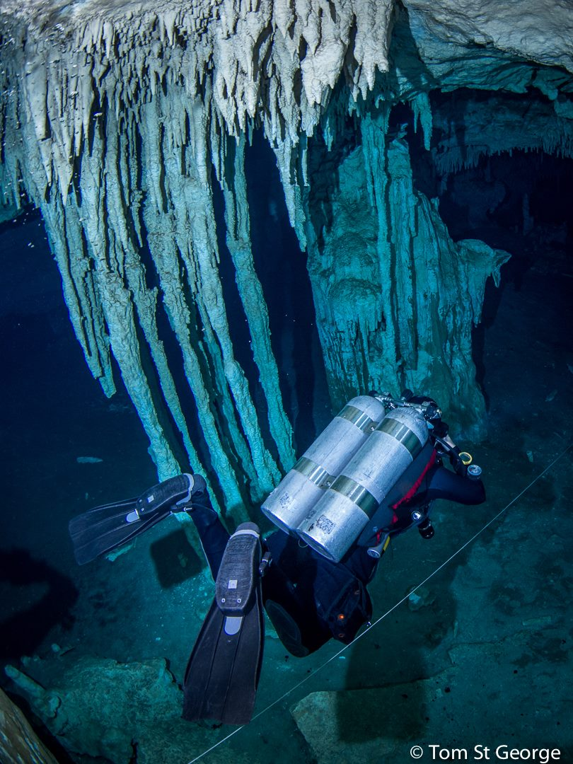
Sport & Information Behaviour Research
Interpersonal relationships and social media are important sources of information in sport and active leisure.
Hungenberg, Ouyang, and Gray (2019): "Adventure tourism"
Bergstrom and Neo (2020): Hai'kū Stairs
Gorichanaz (2017): Ultramarathon runners
Yamashita (2022): "Sports tourists"
Notes:
The information behavior of individuals engaging in sport and active leisure pursuits have been studied.
Hungenberg, Ouyang, and Gray surveyed participants who competed in “adventure tourism” events (such as white-water rafting, surfing, and sportfishing), finding individuals seek information from the internet, print/media resources, and through interpersonal relationships.
A case study by Bergstrom and Neo examined hikers’ information-seeking behaviors of a popular (yet illegal) hike in Hawai’i. A thematic analysis of 111 survey responses found that hikers sought information online, using blogs, social media, and reviews.
In a study on ultramarathon runners, Gorichanaz found that race report documentation helps athletes choose, prepare, and pre-experience races before a marathon, as well as communicate their post-ultrarunning experiences.
In a scoping review, Yamashita found that “sports tourists” increasingly rely on social media to find information that mitigates risk associated with activities such as hiking, bison-watching, skiing, snowboarding, and trekking.
The activities studied are varied and point to the importance of interpersonal relationships and social media to support their pursuits.

Slide 9
Research Methodology
The study uses the Information World Mapping technique developed by Greyson, O’Brien and Shoveller. This methodology uses a participatory art-based technique for conducting information behaviour interviews. The technique encourages participants to both draw their information seeking pathways and at the same time talk through their process.
Greyson, D., O’Brien, H., & Shoveller, J. (2017). Information world mapping: A participatory arts-based elicitation device for information behavior interviews. Library & Information Science Research, 39(2), 149-157.
Notes:
Our research used qualitative, one-on-one semi-structured interviews and the arts-based information world mapping technique. The IWM technique helped guide the conversation with participants, as they visualized and illustrated depictions of their information practices. As explained by Given et al., information world mapping "can aid in the illustration of participants’ perspectives by allowing an audience to not just hear their words, but also experience the world the way they see it."

Slide 10
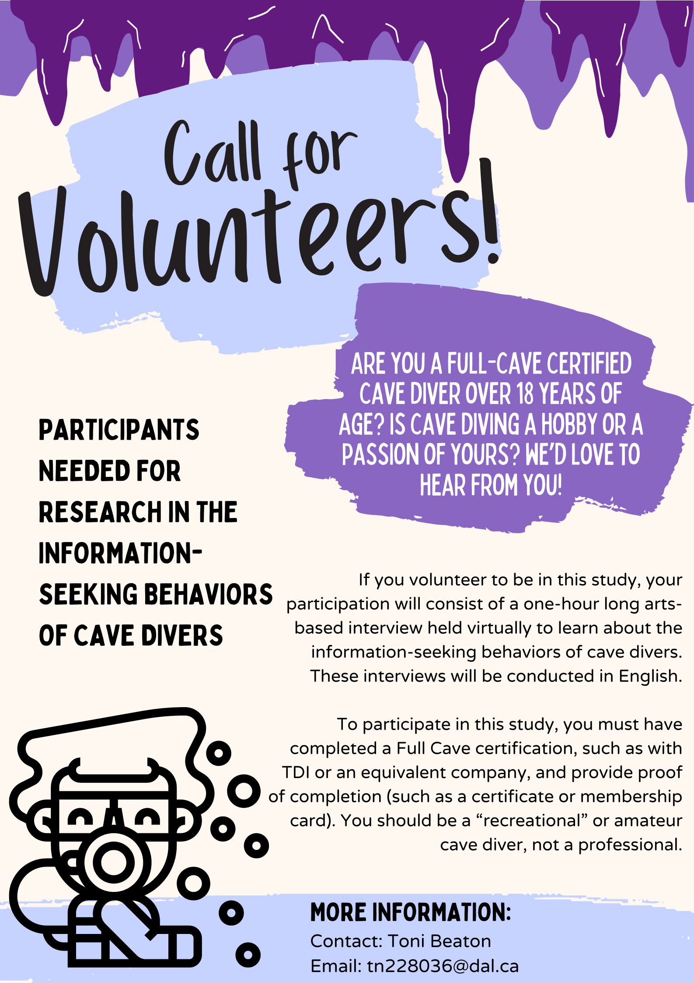
Recruitment & Participant Criteria
20 participants
6 female-presenting
14 male-presenting
International representation
Australia
Canada
Denmark
Germany
Mexico
Switzerland
The United States
Notes:
Recruitment materials were posted to the public Facebook group “Cave Diving.” Data was collected from twenty voluntary participants using Microsoft Teams to host online interviews. Participants were technical cave divers 18+ years of age who successfully completed TDI's Full Cave certification, or equivalent. Participants hailed from Australia, Canada, Denmark, Germany, Mexico, Switzerland, and The United States. Six participants were female-presenting, and fourteen were male-presenting. Four participants were self-proclaimed ‘exploration’ divers, actively working towards the surveying of unexplored caves. Sixteen participants were hobbyist cave divers.

Slide 11
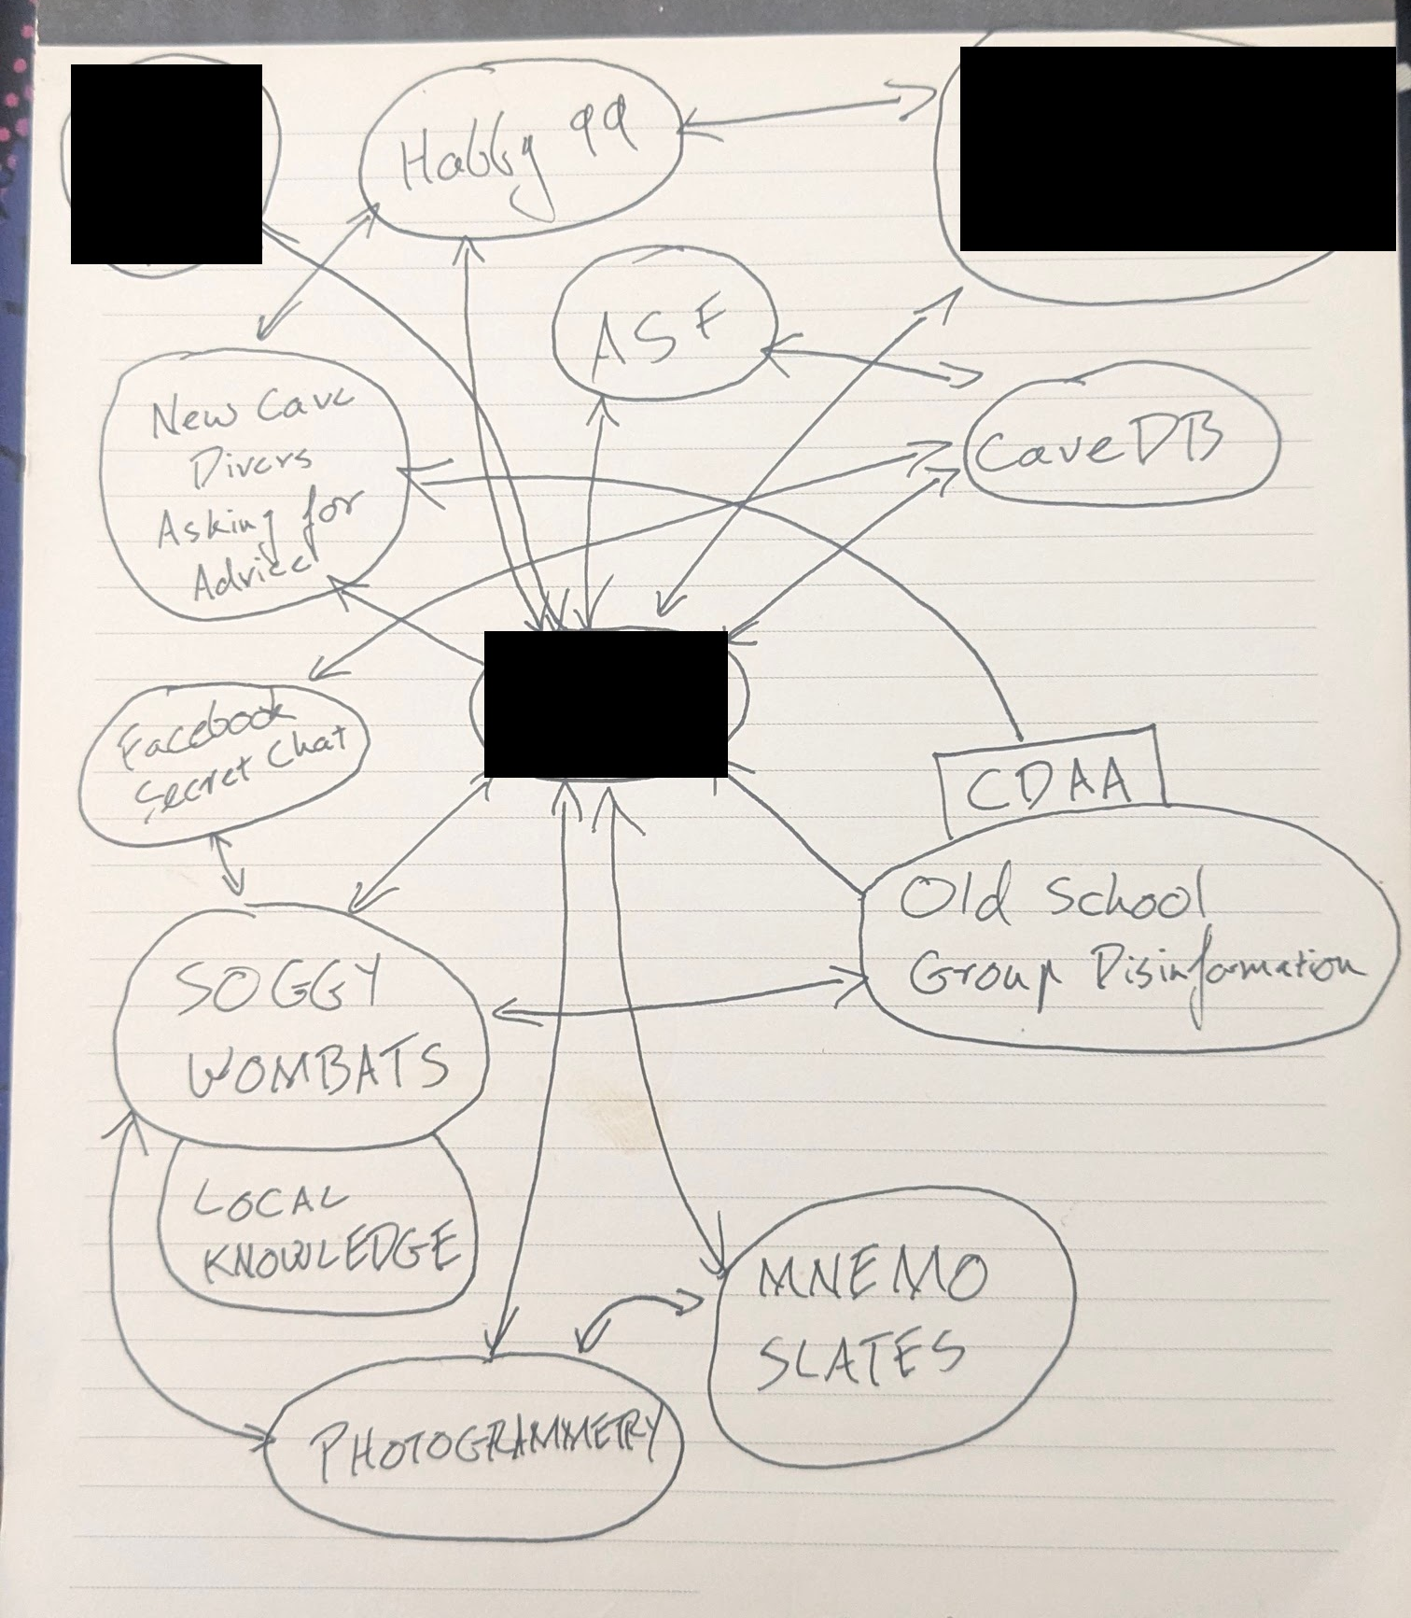
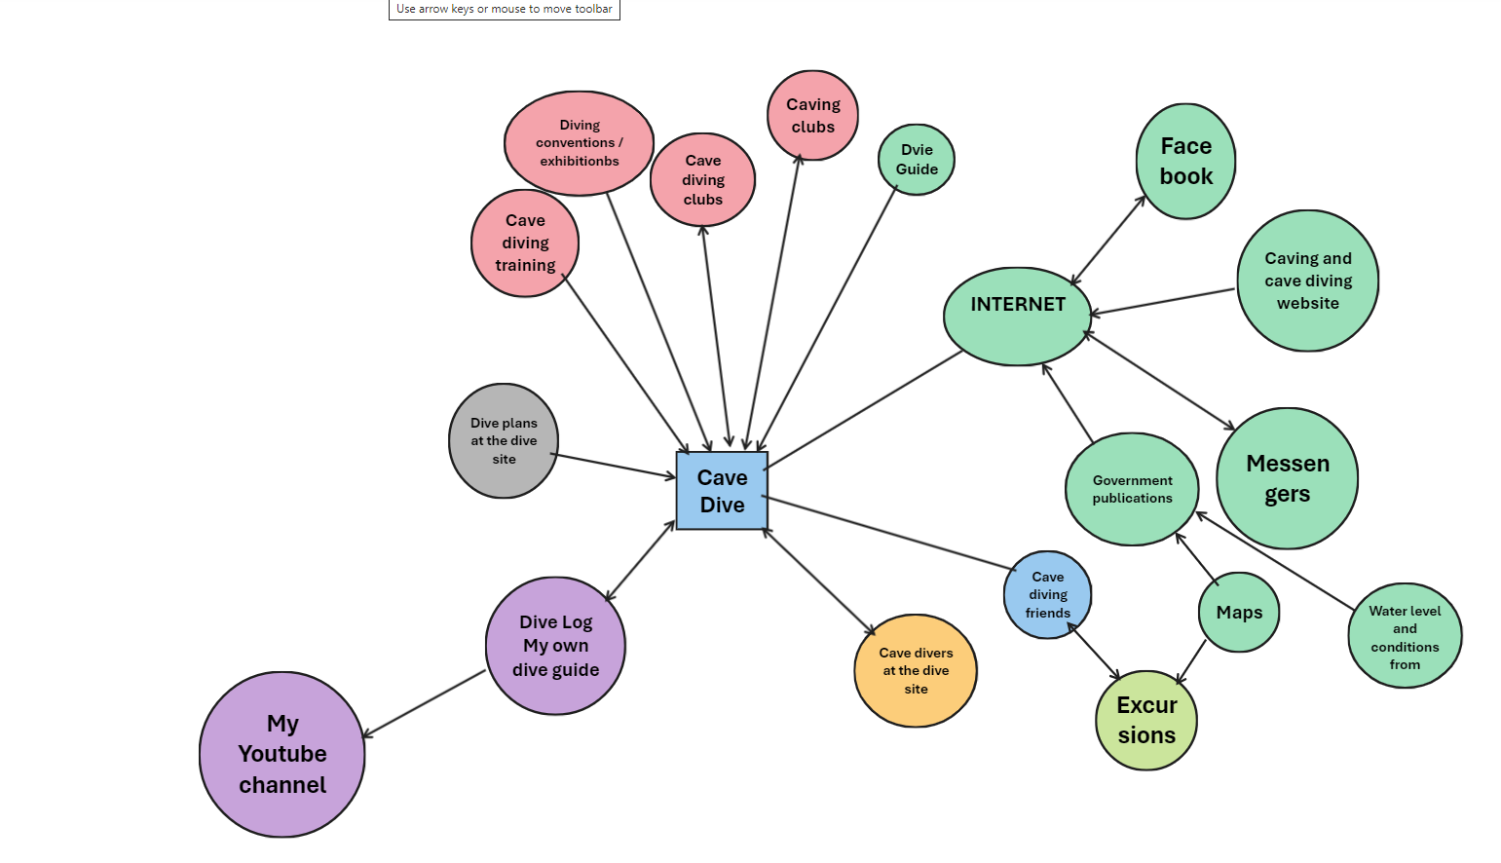
Data Collection
Notes:
Pictured on this slide are two examples of participant information world maps. Both the information world maps and the interview transcripts served as primary sources of data for conventional thematic content analysis.

Slide 12
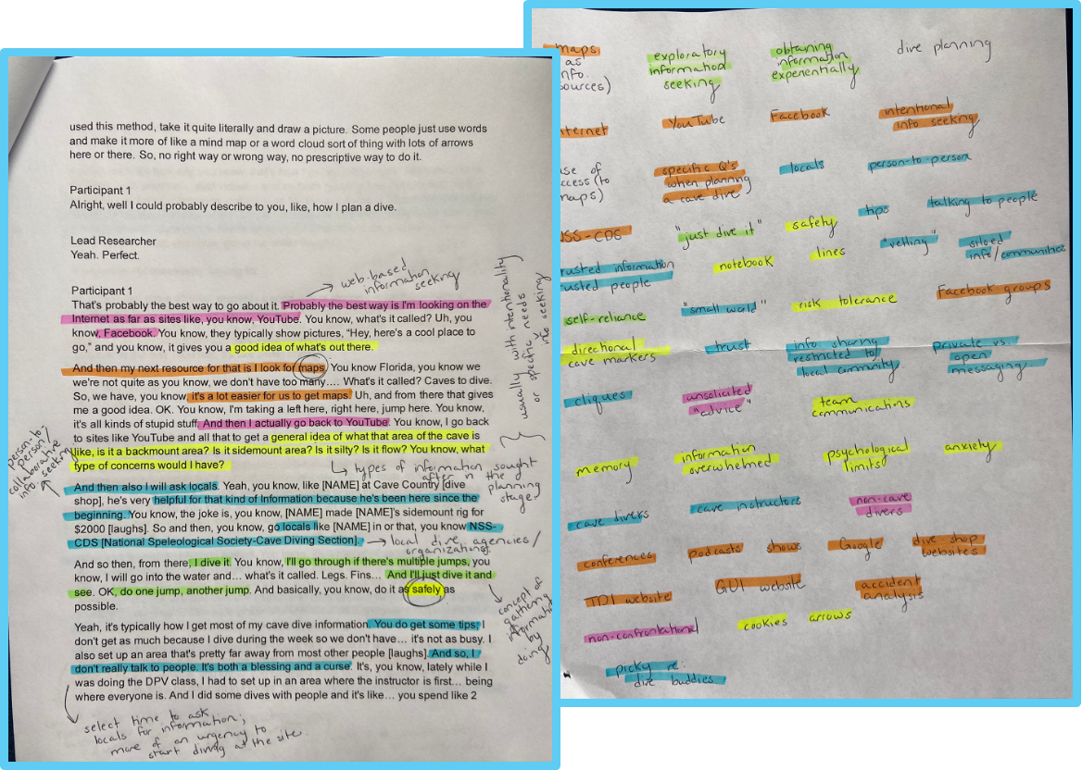
Data Analysis
Notes:
When assigning themes, recurring information was considered, noting similarities. During the first read-through, overlapping salient themes became clearly visible. The next stage of coding involved searching for themes that remained unmarked; this enabled “less obvious themes” to emerge in the second pass. Through careful examination and constant comparison, themes were developed directly and inductively.

Slide 13
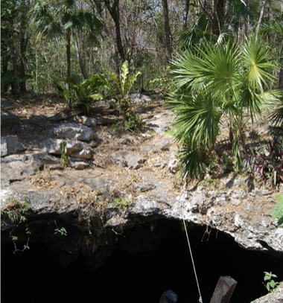
Identified Themes and Early Results
Notes:
Analysis revealed six overarching themes, which we'll now explore.

Slide 14
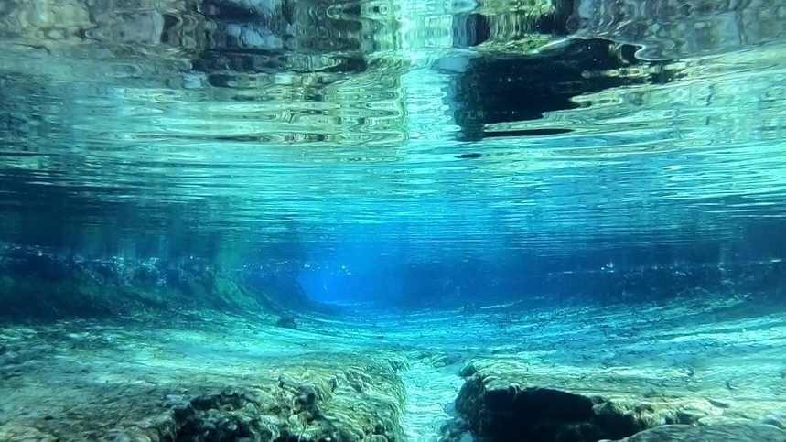
Intentional, Targeted Information Seeking
“I need to emphasize this, ‘cause it’s the first thing to do for me most of the time: just Google what information is there about a particular cave, specific place or region. There is already a tricky part because there is a lot of old information or misinformation. You really need to filter out a lot of the stuff.” - P4
Notes:
When planning a dive, cave divers’ information-seeking behaviors are efficient and deliberate, and answers are sought for specific queries. For example, a cave diver may have an information need based on a cave location, water conditions, or piece of equipment specifications. Google was consistently mentioned as the predominant source of online information gathering, with the caveat of having to ‘dig’ deeper to find useful, relevant information. Online sources such as podcasts, collected data, specialized forums, and websites all served to act as Dervin's Sense-Making information "bridges" to overcome information "gaps". Another important direct source of targeted information-gathering comes from cave maps, which are extremely helpful in the planning of safe dives. Examples of other direct sources include local dive shops, cave conferences, and government publications.

Slide 15
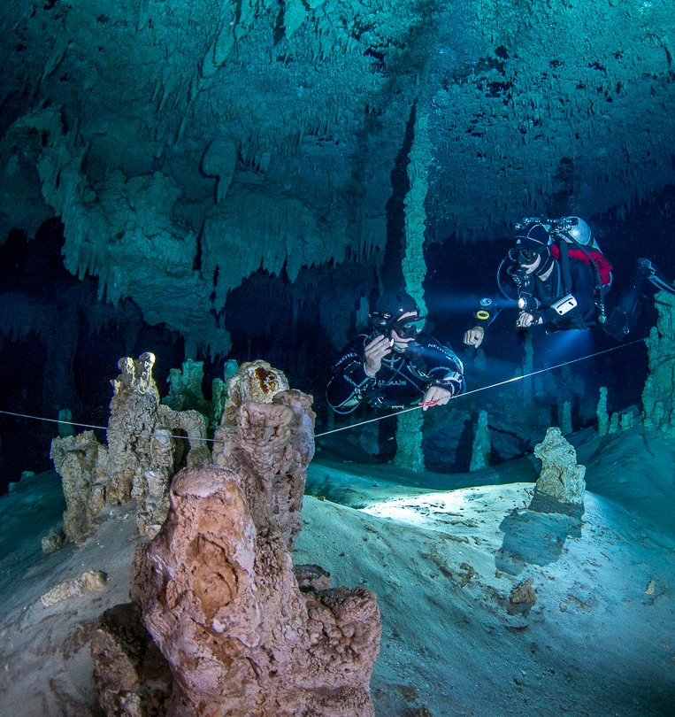
Person-to-Person Information Exchanges
“At this level of cave diving, you’re generally going to be vetting anyone that you come in contact with. It will become very apparent very quickly through verbal and nonverbal vetting, whether or not that’s someone that I would feel comfortable at least doing some initial exploratory, see-how-the-dynamic-works type dive.” - P11
Notes:
In the cave diving community, information is not exchanged freely, and careful considerations are made as to who may be included. Relationships are built on confidence, trust, respect, a shared mindset, honesty, and willingness for reciprocity. The “give and take” of information is instrumental in the collaborative process. Information was seen as being siloed to specific cave diving communities, not only geographically (e.g., Florida versus Mexico), but also within the “niche,” “secret society,” “small community” of cave divers.

Slide 16
Person-to-Person Information Exchanges:
Vetting
“If I haven’t dove with a person before, I’m way more conservative about how far we go in and what we do. If you and I were doing a dive right now, I wouldn’t want to do jumps. I would want to stay mainline. I would communicate that.” - P15
Notes:
Many participants emphasized the importance of “vetting” an individual. Vetting is a process of determining whether an individual can be trusted to exchange information, and may occur instantaneously. Verbal and nonverbal vetting may occur through inspecting:
The handling and maintenance of one’s gear/equipment
Confirmation of cave diving credentials, agency, and/or instructor
Word of mouth about one’s reputation
And more.
Cave divers have private methods of circulating information about ‘unofficial’ cave sites, intentionally restricting information for both conservation and safety concerns. Contrasting Bergstrom and Neo’s case study analysis of the Ha’ikū Stairs in Hawai’i, this study’s findings indicate cave divers will actively avoid posting such information online, especially on platforms accessible by the public or recreational SCUBA divers. Information is shared in such a way that it remains private and restricted versus publicized. There is a sense that such information should remain within – and be protected by – the small, vetted community. This concept aligns with Chatman’s theory of the “small world,” as the personal perception of others within a community can change the ways in which people interact and share information amongst themselves. A person’s reputation within a small “siloed” world influences whether others within the same community will engage in information exchanges.

Slide 17
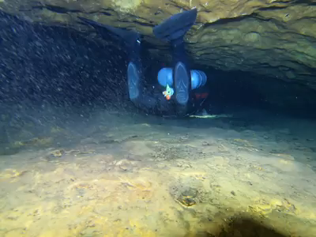
Experiential Information Gathering
Notes:
Participants voiced a spirit of “progressive penetration” of the cave, with dives that were not necessarily goal oriented. Participants expressed a style of “on the fly” information gathering, such as “figuring things out” at the dive site or driving around the countryside searching for caves. In contrast to the targeted information-seeking behaviors displayed before the cave dive, participants expressed that informal or unsolicited information could be exchanged through interactions with other vetted divers at the site.

Slide 18
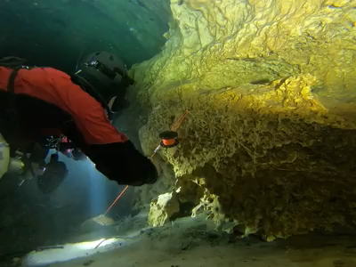
Embodied Information Gathering
“When you’re actually in a cave, if you’re not in the moment, you’re potentially in deep trouble. For that... [time] you’re in that cave, you are doing that thing because if you’re not, you’re potentially putting yourself and everyone else at risk. It’s very focused for the time that you’re doing it.” - P17
Notes:
Many cave divers engage in informal information gathering during the dive, from experiencing and being within the cave itself. Embodied information gathering was seen through interactions with the cave guideline, markers such as REMs, “confidence” cookies, arrows, and cave formations. Many participants highlighted the importance of “reading the cave” and “backreferencing”, even assigning names to unique formations (e.g., a “popcorn floor” or “croissant” stalagmite). By immersing themselves in the cave and remaining open and receptive to encountering new passageways or areas, divers gather information in an embodied fashion. This information gathered during a dive reflects the experiences of one’s body in a physical space, thereby creating muscle memories.
A recurring theme was the importance of keeping one’s head completely in the cave, referring to it as a “meditative,” “deeply relaxing,” and “yogic” experience. Due to the demanding nature of cave diving, if a diver takes themselves outside of this embodied information gathering mindset, problems may arise.

Slide 19
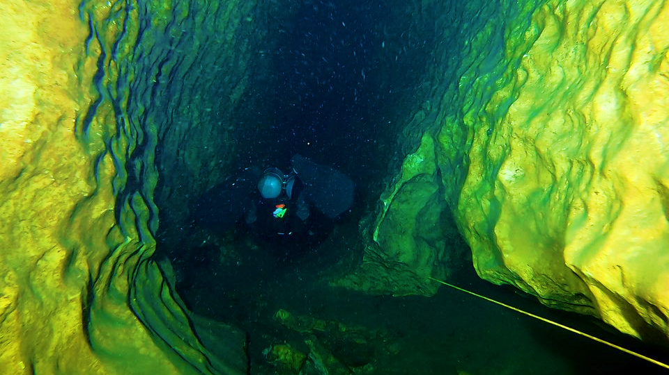
The Avoidance of Becoming "Information Overwhelmed"
“In general, I don’t take a lot of information on the dive. If navigation is really complex, I might write it down, but in general I’m not doing very complex navigation in a place I’ve never been before. I kind of think if you need to rely on information that’s written down, you maybe shouldn’t be doing the dive.” - P2
Notes:
Participants expressed the need for a calm, collected mindset prior to entering the cave, to avoid becoming emotionally, psychologically, or informationally overwhelmed. This theme is tied to an embodied information gathering mindset; a person should not enter a cave inattentive to their surroundings. Rather than being hyper-focused or goal-oriented on reaching a section of cave, participants expressed the need to dive within one’s limits and approach the cave systematically.

Slide 20
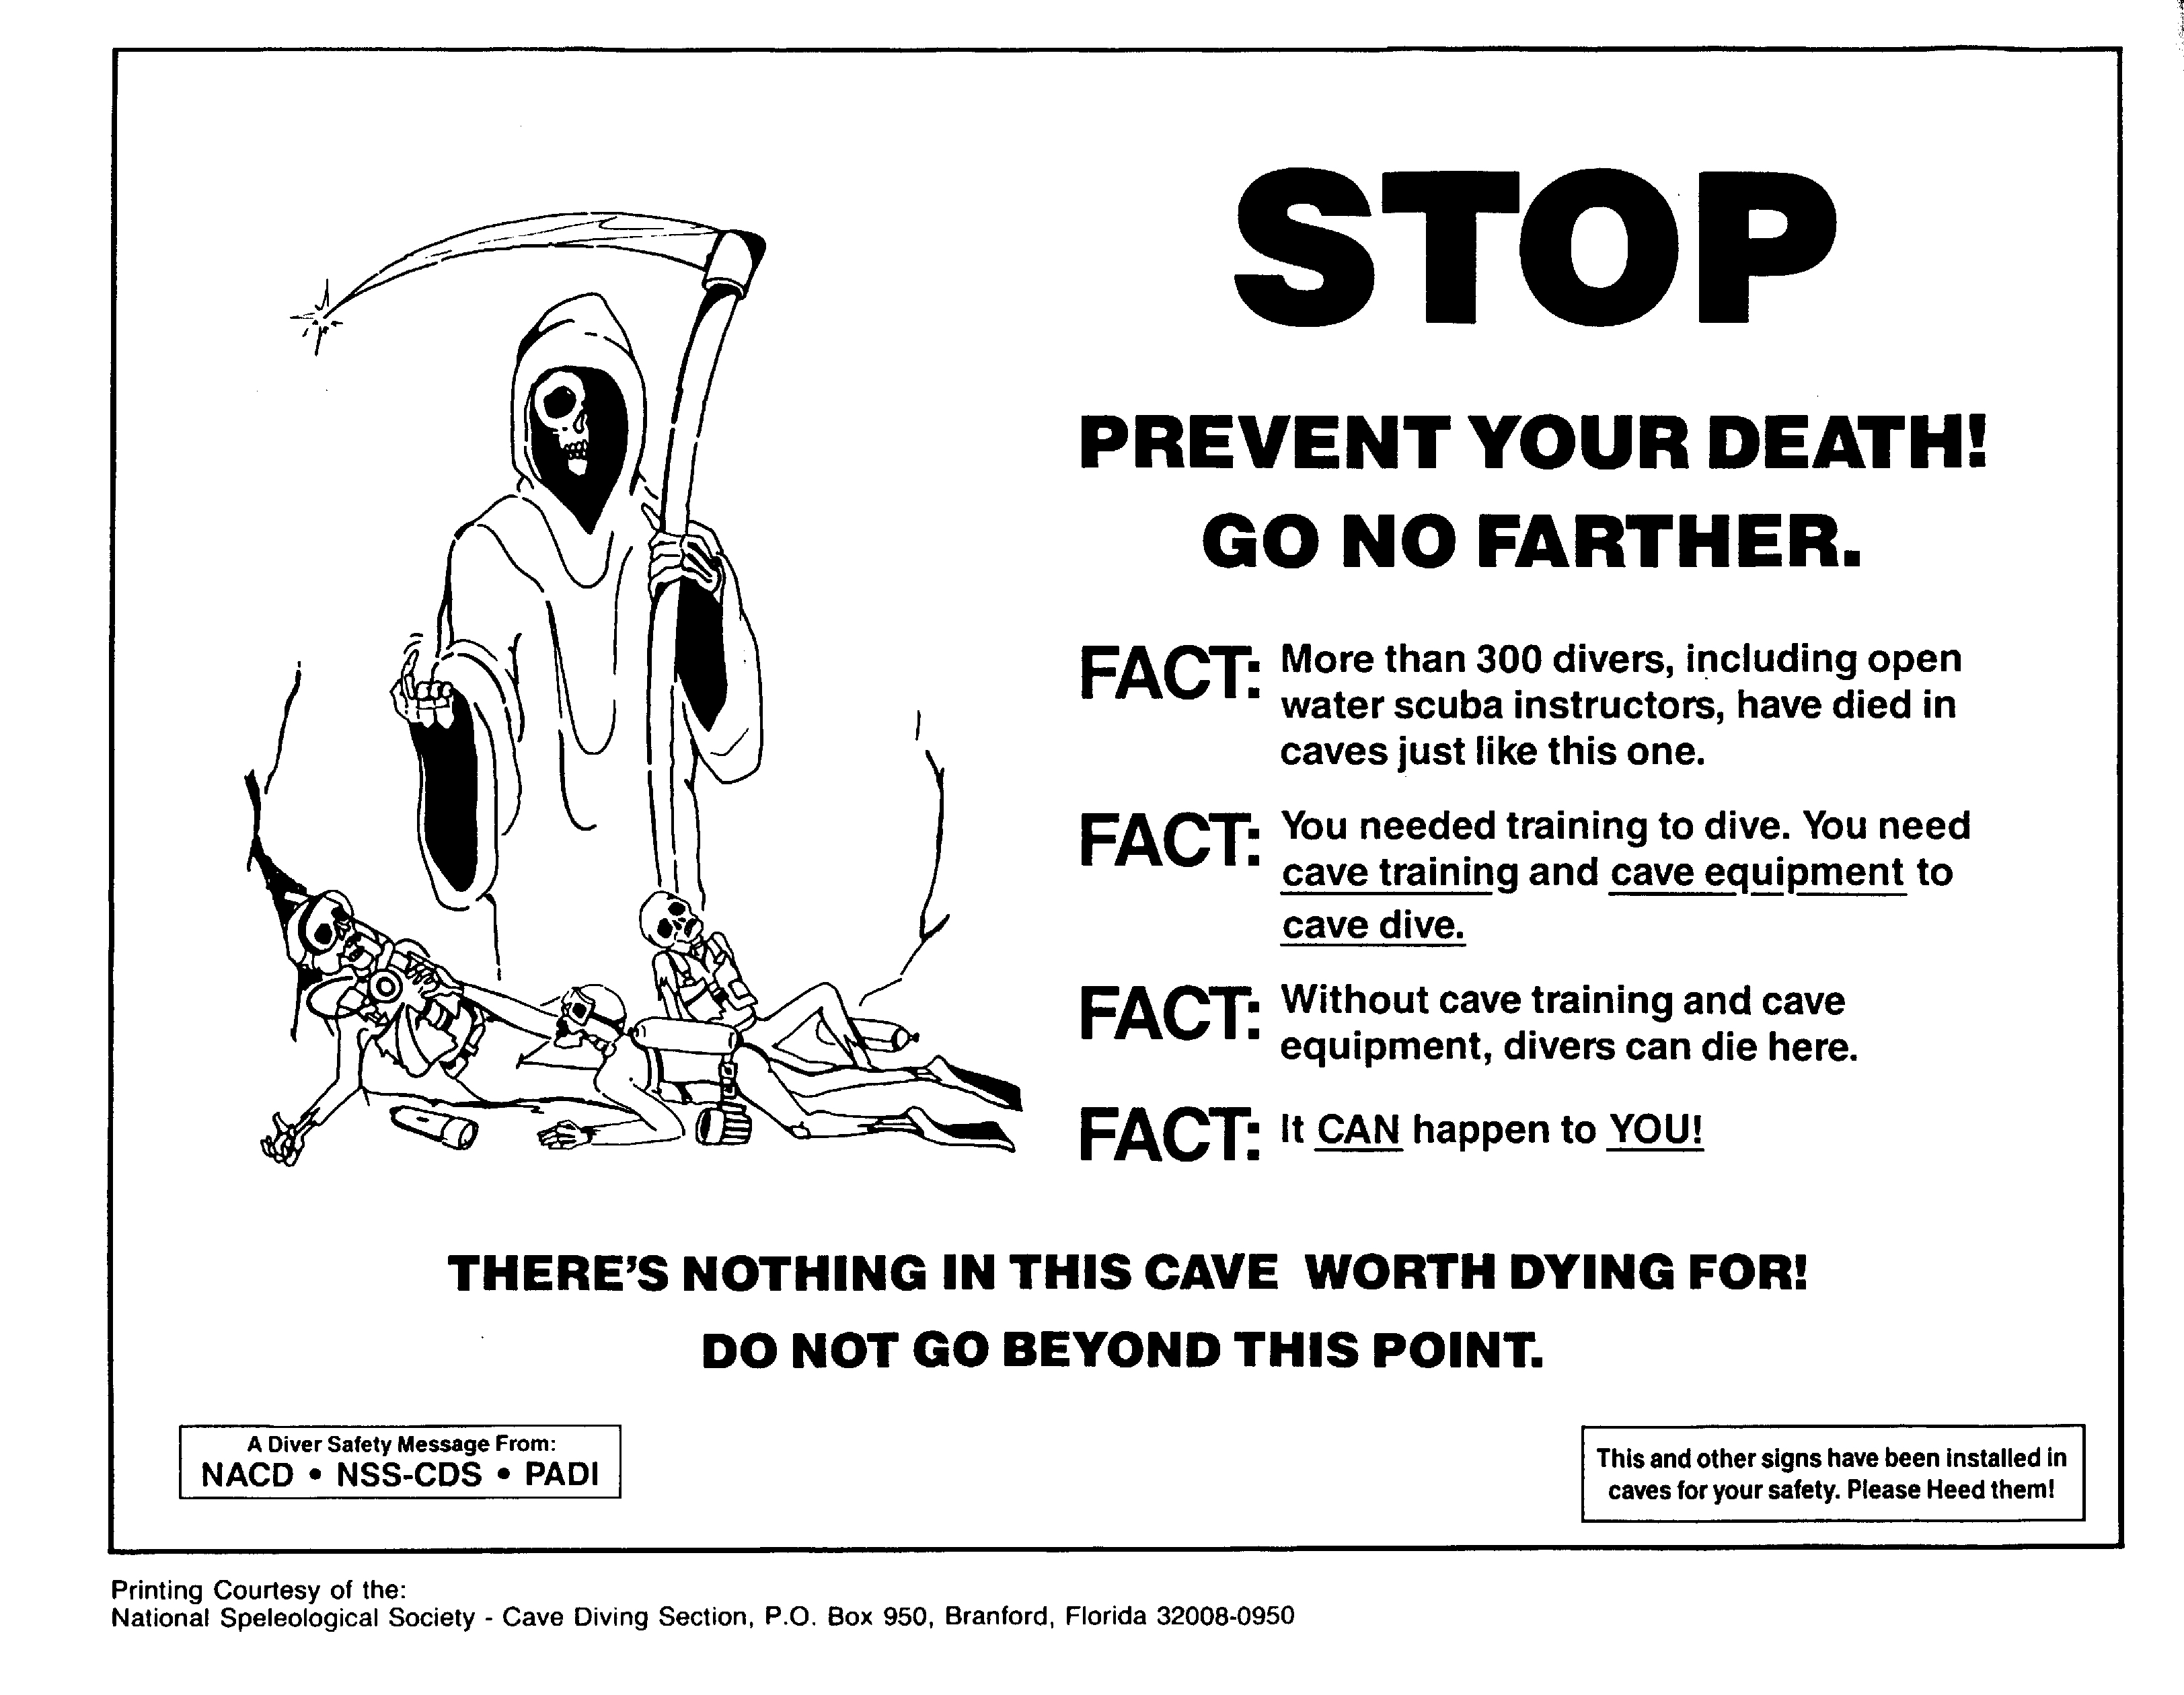
Information as a Safety-Oriented Practice
“I don’t do it for high risk. I do it for low risk, and it’s extremely meditative for me. Everyone has to evaluate their own risk-reward decisions profile, and what you’re comfortable with doing. I don’t think in all my years of diving I've ever done something for the excitement of it. Not once. Doesn’t even enter my mind.” - P11
Image source.
Notes:
For cave divers, information is a tool to follow best practices for safety, commonly known as ‘accident analysis.’ Cave fatalities are analyzed, in the hopes that future accidents can be avoided. This information-seeking is noteworthy, as people usually avoid information that can cause them to feel uncomfortable, especially when related to one’s health or wellness. However, for cave divers, accident analyses serve as an important tool for information gathering. Risk analysis and tolerance were consistently mentioned as paramount factors when planning, executing, and debriefing a safe cave dive. Divers often self-reflected as being hyper-vigilant and safety-oriented.

Slide 21
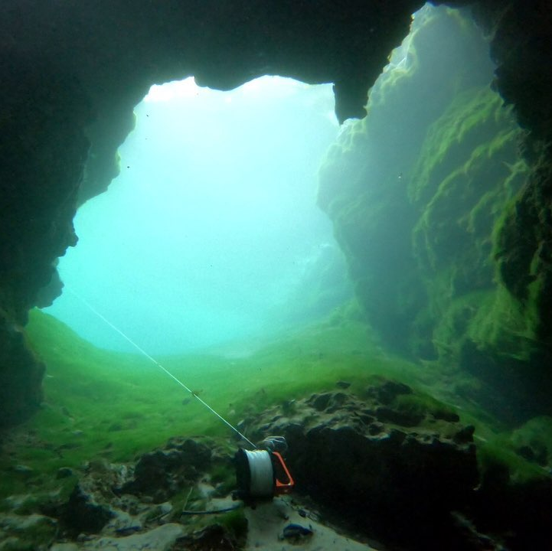
Information is integral to the sport of cave diving, acting as an indispensable part of the equipment and critical to the relationship between divers and the environment.
Notes:
Preliminary research results found that cave divers use targeted, action-oriented information-seeking behaviors, engaging in collaborative exchanges with trustworthy, vetted community members. Cave divers are highly engaged in various kinds of information-seeking behaviors where participation in the sport demands a high degree of engagement with several information sources, and where information plays a highly critical role within the sport itself.

Slide 22
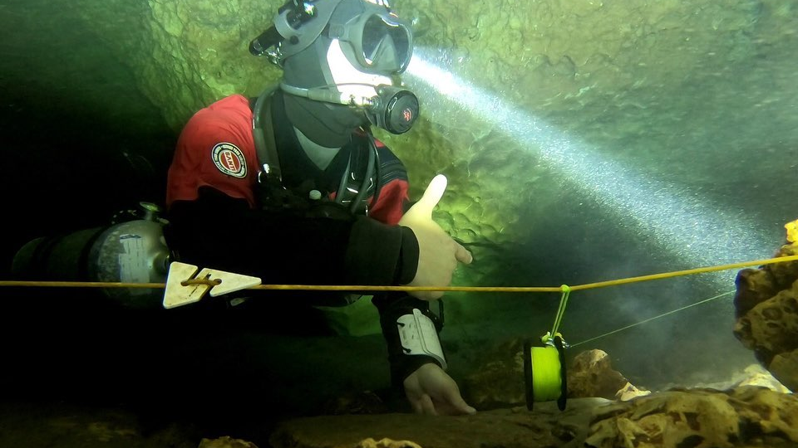
Interesting "Cookies" to Follow...
Gender imbalances
Geographic differences
Generational differences
Public perception
Notes:
From the transcription data emerged several interesting themes which could be explored in further research:
Gender imbalances
An imbalance in terms of initially trying out the sport; females were much more hesitant and focused on safety concerns, avoiding the "zero to hero" progression of cave training
Geographic differences
Data which emerged from North America versus Europe versus Australia had very distinct geographical considerations regarding training organizations, sharing of information locally, and interaction between divers at the dive sites
Generational differences
Younger generations referred to a strict and standoff-ish "Old Boys Club” that spread misinformation to “protect” cave sites, whereas older generations viewed up-and-coming cave divers as more reckless, potentially compromising the safety of the sport
Public perception
Cave diving, as a sport, is less "risky" than the public might think
Participants felt offence taken to having cave diving lumped in as a 'high risk' sport, as it isn't done for any risk factor and was described as a 'meditative' experience

Slide 23
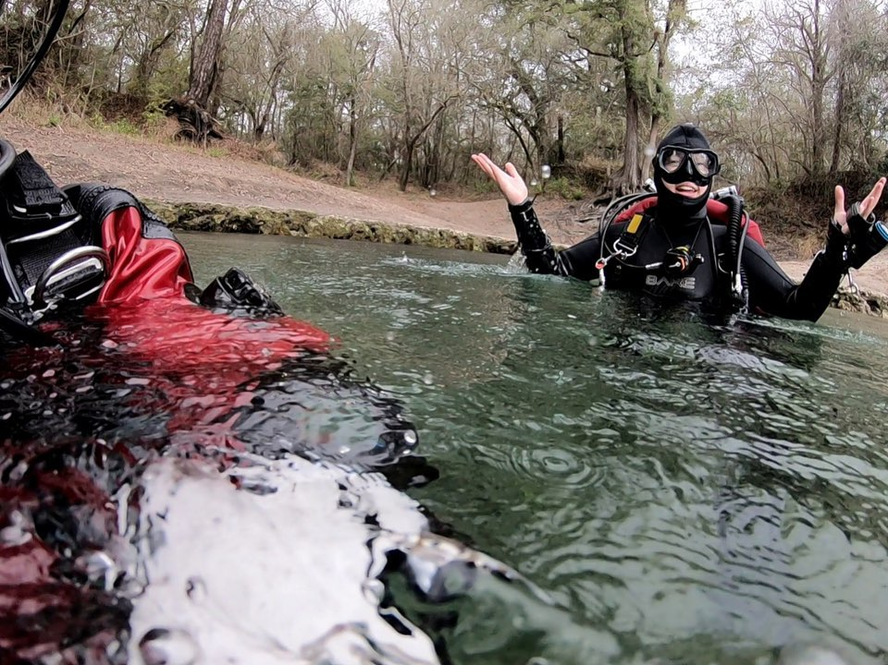
Extending our Results Beyond the Cave
"There's old mountaineers and there's bold mountaineers. There's no old, bold mountaineers. That works the same for cave diving." - P15
Notes:
The high-risk nature of information sharing, as seen in cave diving, carries implications for various information seekers.
The patterns in this study suggest that information behavior and information-sharing, more specifically, is highly influenced by community positioning. These findings also align well with scholarship such as Hertzum’s content analysis review, which found that individuals will consult other people within their community for information, only of whom they hold in high regard.
Gatekeeping of information is approached as a necessary evil within the cave diving community. If a non-vetted diver displays undesirable characteristics, then divers will informationally shun that community member, withholding any and all information as necessary. The gatekeeper of information, then, exhibits power in information-restriction. This aligns with Savolainen’s research, as the power dynamics between a gatekeeper and those subject to gatekeeping vary drastically, depending on whether the person subject to gatekeeping has access to any alternative forms of information-gathering. However, in such a “niche” “small community”, having information withheld – in any form – can be detrimental to one’s development in that area of serious leisure interest.

Slide 24
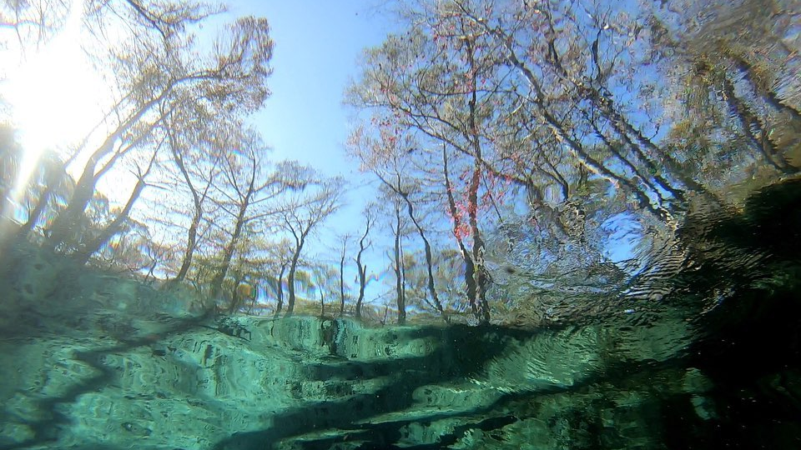
Bergstrom, K., & Neo, R. (2020). Searching for the stairway to heaven: Information seeking about an illegal hiking trail in Hawai’i. Leisure Studies, 39(5), 751-764. https://doi.org/10.1080/02614367.2020.1770844
Braun, V., & Clarke, V. (2006). Using thematic analysis in psychology. Qualitative Research in Psychology, 3(2), 77-101. https://doi.org/10.1191/1478088706qp063oa
Breivik, G. (1999). Empirical studies of risk sport. Oslo: Norges idrettshøgskole, Institutt for samfunnsfag.
Chatman, E. A. (1999). A theory of life in the round. JASIS, 50(3), 207–217. https://www.proquest.com/docview/231397230?sourcetype=Scholarly%20Journals
Cohen, R., Baluch, B., & Duffy, L. J. (2018). Defining extreme sport: Conceptions and misconceptions. Frontiers in Psychology. https://doi.org/10.3389/fpsyg.2018.01974
Dervin, B. (1998). Sense-making theory and practice: An overview of user interests in knowledge seeking and use. Journal of Knowledge Management, 2(2), 26-46. http://doi.org/10.1108/13673279810249369
Given, L. M., Opryshko, A., Julien, H., & Smith, J. (2011). Photovoice: A participatory method for information science. Proceedings of the American Society for Information Science and Technology, 48. http://dx.doi.org/10.1002/meet.2011.14504801209
Gorichanaz, T. (2017). The information of story: The genre and information activities of ultrarunning race reports. Aslib Journal of Information Management, 69(4), 460–474. https://doi.org/10.1108/AJIM-03-2017-0071
Greyson, D., O’Brien, H., & Shoveller, J. (2017). Information world mapping: A participatory arts-based elicitation device for information behavior interviews. Library & Information Science Research, 39(2), 149-157. https://doi.org/:10.1016/j.lisr.2017.03.003
Hertzum, M. (2016). Collaborative information seeking and expertise seeking: Different discourses about similar issues. Journal of Documentation, 73(5), 858-876. https://doi.org/10.1108/JD-04-2016-0053
Hungenberg, E., Ouyang, L., & Gray, D. (2019). Measuring the information search behaviors of adventure sport tourists. Event Management, 23, 75-91. https://doi.org/10.1080/10413209808406392
Laviolette, P. (2007). Hazardous sport? Anthropology Today, 23(6), 1-2. https://doi.org/10.1111/j.1467-8322.2007.00545.x
Narayan, B., Case, D., & Edwards, S. L. (2011). The role of information avoidance in everyday life information behaviors. Proceedings of the American Society for Information Science & Technology, 48(1), 1-9. https://doi.org/10.1002/meet.2011.14504801085
Robinson, J., & Yerbury, H. (2015). Re-enactment and its information practices; Tensions between the individual and the collective. Journal of Documentation, 71(3), 591-608. https://doi.org/10.1108/JD-03-2014-0051
Ryan, G. W., & Bernard, R. (2003). Techniques to identify themes. Field Methods, 15(1), 85-109. https://doi.org/10.1177/1525822X02239569
Savolainen, R. (2020). Manifestations of expert power in gatekeeping: A conceptual study. Journal of Documentation, 76(6), 1215-1232. https://doi.org/10.1108/JD-01-2020-0010
Stebbins, R. (2009). Leisure and its relationship to library and information science: Bridging the gap. Library Trends, 57(4), 618-631. https://doi.org/10.1353/lib.0.0064
Yamashita, R. (2022). A quantitative scoping review of information search behaviour in sport tourism. The Journal of Sport Tourism, 26(4), 363–386. https://doi.org/10.1080/14775085.2022.2098807
Notes:
Here are our references for this presentation.

Slide 25
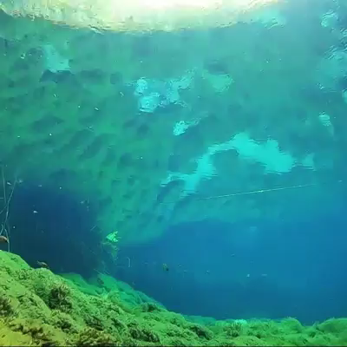
Questions?
beatont@halifaxlibrary.ca
Notes:
Thank you so much for your attention! At this time, we would like to welcome any questions you may have.

